Slide 1


March Webinar on Extremely Exciting Topics
Jim McErlean – Business Development Director, Cannasure
Stuart Worthington – Vice President, Director of Marketing, Benchmark Insurance
March 8, 2023

Slide 2


Agenda
11:00-11:05
Welcome + Introductions
11:05-11:20 – Jim McErlean
MGA Program updates
Streamlined Renewal Process
Claims Insights
11:20 – 11:30 – Stuart Worthington – Workers Compensation
11:30 Q&A
In addition to Questions for Stu, please focus some Questions on coverage enhancements you’d like to see implemented in our Flagship MGA program

Slide 3
FLAGSHIP MGA PROGRAM
Property Capacity - $45M per location
Can Cannasure write Monoline Property – YES
Not just in Michigan ☺
Does Cannasure offer Excess Casualty – YES
$5M Excess of $5M or $10M - $5M is only option
Does Cannasure offer Excess Property - YES
Recent placement was $20M xs $20M

Slide 4
FLAGSHIP MGA PROGRAM
Does Cannasure write in the newest states of CT, MO, MD, MN, MS, NJ & NY – YES
What’s next: AL, LA & OK (very selectively would be the key words in OK)
Assault & Battery – absolute exclusion – NO
BuyBack options available!
Consumption Lounges? YES
Initial coverage offering is Premises GL, not true Dram Shop Liability

Slide 5
STREAMLINED RENEWAL PROCESS (COMING SOON!)
Currently in testing, plan is to solicit exposure basis changes, NO APP!
Check on current locations, limits/exposures, A/I endorsements & DONE!
Full rollout planned on June renewals
Did we mention, we won’t be requiring a new business application on a renewal account, welcome to the (almost) standard market of Cannabis!

Slide 6
Cannabis Claim Trends
One insurance company’s experience over 5 years

Slide 7
Assault & Battery
Incident: Patron assaulted in parking lot by unknown assailants
Injury claim brought against insured dispensary
Policy details and coverages?
Coverage issues? – Exclusion, Limited A/B Coverage
Outcome: provided coverage and paid compromise settlement

Slide 8
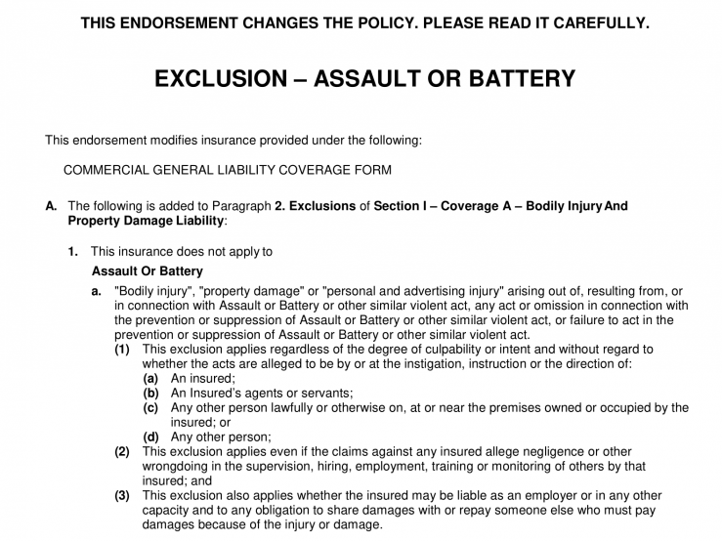
Assault & Battery Exclusionary Endorsement

Slide 9
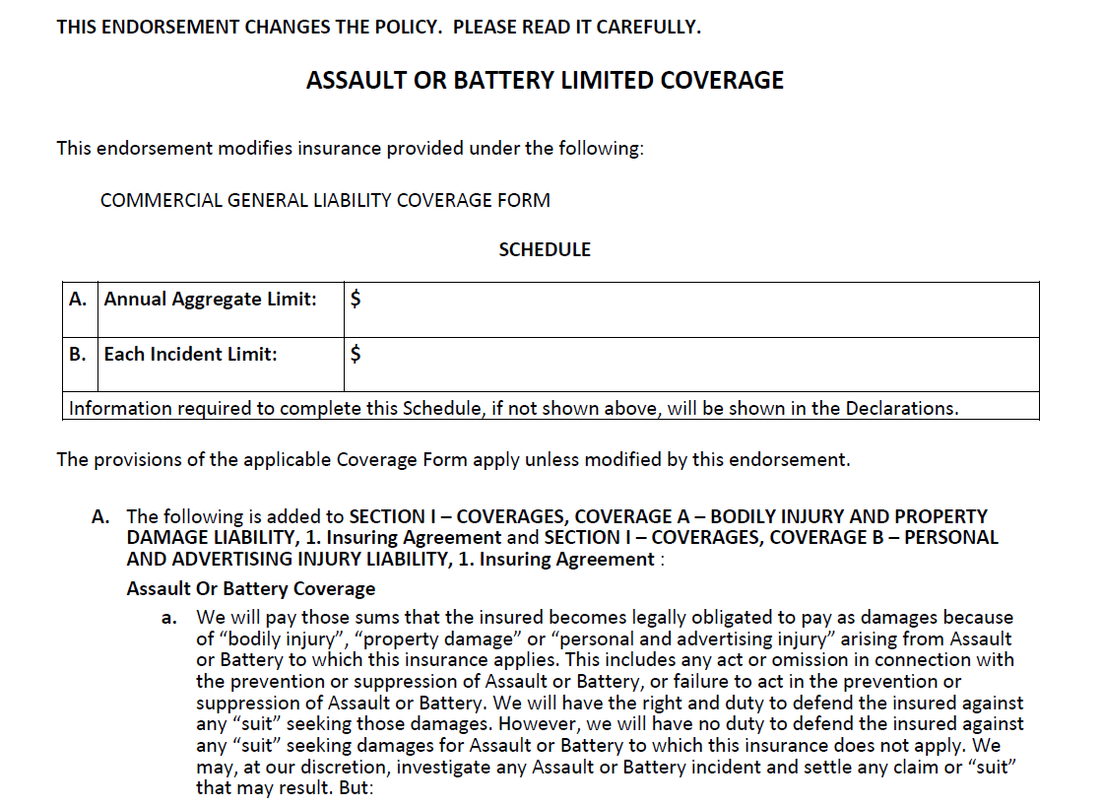
Assault & Battery Limited Coverage Endorsement

Slide 10
Theft & Protective Safeguard(s)
Claim:
After-hours break in at dispensary
Theft of product from multiple locations
Policy details and coverages?
Coverage issues? – “Safe Warranty”
Outcome: partial acceptance of coverage, product not in an approved safe

Slide 11
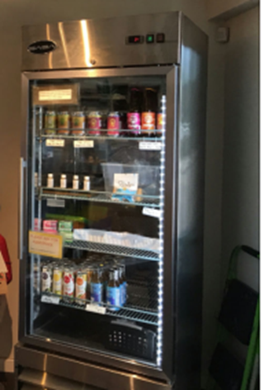
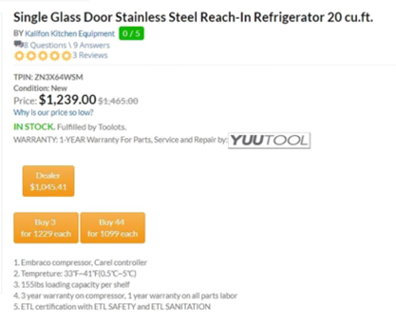
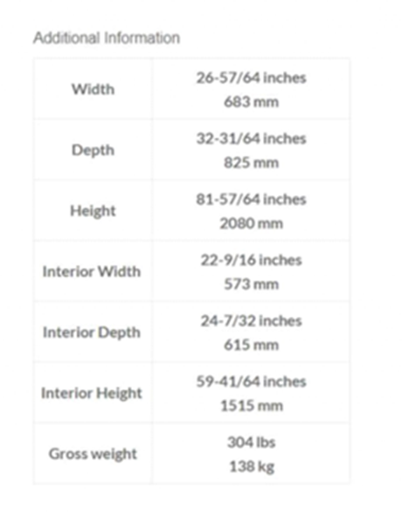
Photo of locked display case

Slide 12
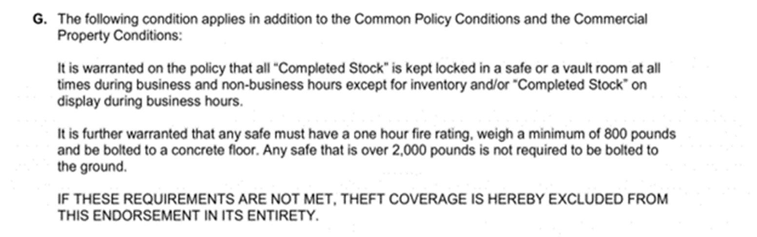
Safe Warranty

Slide 13
Protective Safeguards
Warranties
  Application vs Insurance Program Requirement
Common Protective Safeguards and Warrants
  Fire Sprinkler Protected Buildings
  Fire Extinguisher Servicing for cooking exposures
  Armed Guard and Contractor Risk Transfer
  Active Central Station Burglar
  Control of Industry Material
Loss Control and Mitigation

Slide 14
Grow Lamp Failures
Perils vs Hazards
Fire – the original peril
Underwriting concerns
  High-Intensity Discharge vs Light Emitting Diode
  HIDs: Metal Halide and High-Pressure Sodium
  So many bulbs, so little time
  Risk mgmt culture, maintenance and replacement intervals
  Sprinkler systems and other safeguards
  The living plants under the lights
  Limit adequacy and coinsurance penalties
  Supplemental applications

Slide 15
CLAIMS – Grow Lamp Failures
Claim example:
Fire at indoor cultivation facility caused by explosive failure of metal halide grow lamp
Outcomes: 1) Claim paid; 2) Experience with these types of lighting fixtures has led to the use of separate Lighting supplement to learn more about lighting systems for coverage concerns

Slide 16
Benchmark Work Comp: a discussion w/ Stuart Worthington

Slide 17
Contact Information
  SLIDES WILL BE SENT OUT SHORTLY
Jim McErlean, Business Development Manager
  (602) 363-6652
  jmcerlean@cannasure.com

